Slide 1

Transfer Learning for Improved Image Classification: A Comparative Architectural Study
Navya Tyagi (Enrollment No.: A525117724001) Supervised by Dr. Andrew Lynn

Slide 2

The Need for Efficient Diagnostic AI
Project Goal
To re-engineer and validate a modular Deep Learning Pipeline for rapid, reproducible image classification. The core objective is to benchmark modern Convolutional Neural Network (CNN) architectures against foundational models to find the optimal balance of speed and generalization.
Original Context & Challenge
The pipeline's origin was the urgent classification of COVID-19 in Chest X-Rays (CXR), where speed and accuracy were important for clinical screening. Our challenge was ensuring the pipeline's robustness, efficiency, and architectural future-proofing across diverse imaging domains.

Slide 3
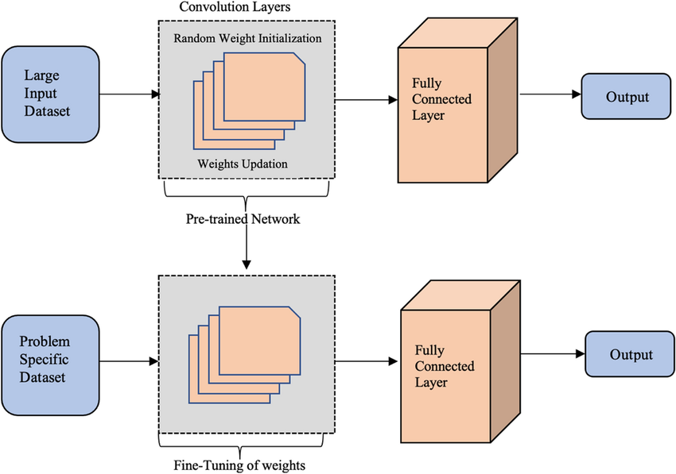
Transfer Learning
Transfer Learning is a machine learning technique where a model trained on one task is repurposed and fine-tuned for a different, but related, task. Instead of training a model from scratch, transfer learning uses the knowledge (features, representations) learned by a pre-trained model, usually trained on large datasets such as ImageNet, to improve performance on smaller or domain-specific datasets.

Slide 4
Benchmarked Architectures
Foundational Baseline: VGG16 & VGG19
Modern Baseline: ResNet50
VGG models are characterized by their architectural uniformity and complexity, providing a valuable baseline
Introduced skip-connections to handle the vanishing gradient problem, enabling the training of much deeper networks.
Enhanced Connectivity: DenseNet121
Key Contribution: EfficientNetB0
Uses dense connectivity, where each layer is connected to all prior layers, resulting in reuse of common features.
State-of-the-art efficiency achieved through a refined Compound Scaling mechanism, optimally balancing network depth, width, and input resolution.

Slide 5
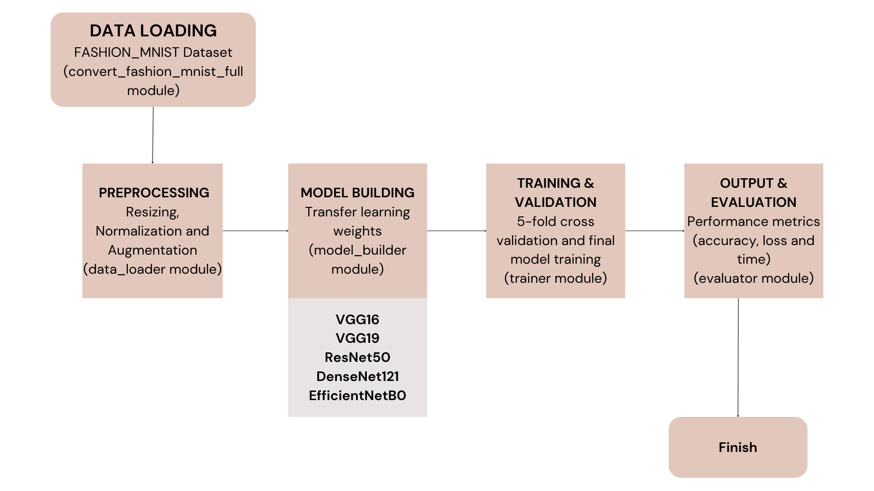
Workflow: Modular Pipeline

Slide 6

Result 1: Peak Accuracy vs. Baseline
The evaluation focused on the Mean Cross-Validation (CV) Accuracy to measure model generalization across all folds (Table 4.1).
97.8%
97.7%
96.3%
DenseNet121
ResNet50
VGG19
Achieved the highest generalization capability with the lowest CV Loss (0.088).
A close second, demonstrating the efficacy of residual connections in deep networks.
Established the performance floor with significantly higher loss, underscoring the limitations of older sequential models.
EfficientNetB0 model achieved an accuracy of 97.0%.

Slide 7
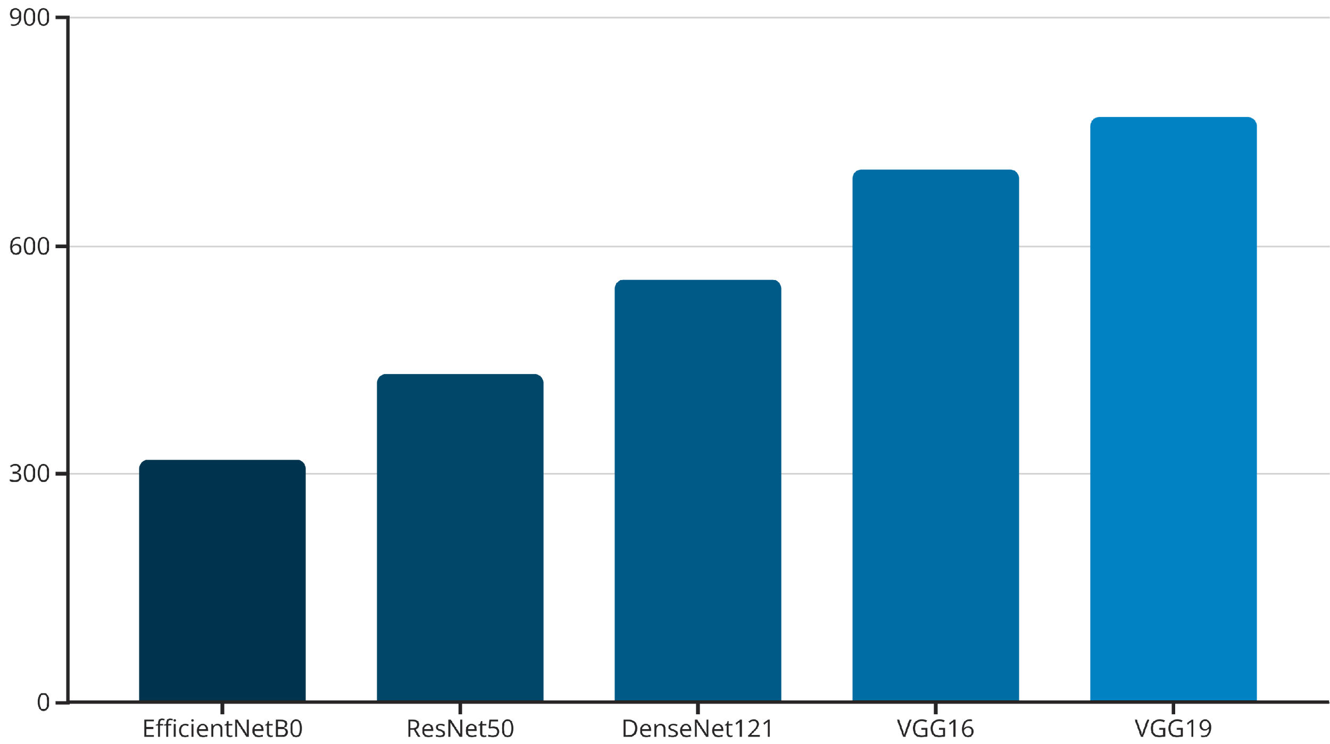
Result 2: Computational Efficiency
We measured the total training time (in seconds) required for all five models to complete the model training.
Key Finding: EfficientNet Dominance
EfficientNetB0 was the clear leader in speed, training in only 319.07 seconds.
It was 1.35x faster than ResNet50 and 2.4x faster than VGG19 (the slowest model).
Conclusion: The integration of EfficientNet successfully introduced a low-cost, high-speed option that dramatically reduces experimental turnaround time.

Slide 8
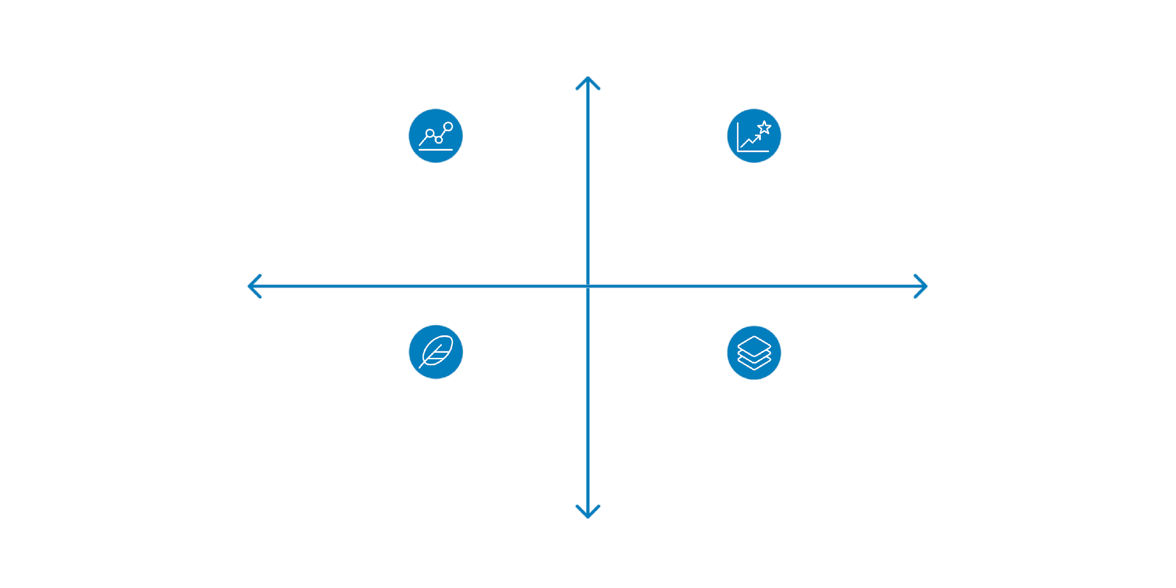
Synthesis: Accuracy vs. Efficiency Trade-Off
High Accuracy
DenseNet121 — High accuracy, slow
EfficientNetB0 — High accuracy, fast
Slow Computation
Fast Computation
Lightweight CNNs — Low accuracy, fast
VGG Models — Low accuracy, slow
Low Accuracy
The optimal choice of architecture depends on the deployment environment and the criticality of accuracy versus speed.

Slide 9


Why FASHION_MNIST?
Scientific Necessity
Avoiding Clinical Confounds
FASHION_MNIST Benefits
We transitioned from the initial COVID-19 CXR dataset to FASHION_MNIST to ensure a completely unbiased architectural comparison.
Clinical data often contains confounding variables (limited size, acquisition bias) that can obscure the true performance differences between models.
Provides a large-scale, publicly accessible benchmark to rigorously measure the specific differences in efficiency and generalization capability.
Validation of Pipeline Mechanics
Testing on a new, non-medical domain conclusively validated that the modified pipeline mechanics, including the integration of modern models like EfficientNet, function optimally and are ready for deployment across domains.
This demonstrates the general-purpose capability and extensibility of our re-engineered framework.

Slide 10

Future Work
Final Validation on Original Domain
Re-test the updated pipeline, including EfficientNet, on the COVID-19 detection task to quantify performance gains in a clinical setting.
Prove Universal Robustness
Test the full architectural suite on a third non-medical domain (e.g., satellite imagery or food classification) to confirm universal generalizability.
Integrate Advanced Strategies
Incorporate Model Interpretability (e.g., Grad-CAM) and Active Learning to reduce labeling effort and increase the accountability of the AI system.

Slide 11
Conclusion: A Robust, Extensible Framework
1
Modernized Pipeline
2
Architectural Benchmarking
3
Validated Generalization
We successfully re-engineered and modernized a standards-compliant Deep Learning pipeline ready for high-performance deployment.
DenseNet121 provided peak accuracy, but EfficientNetB0 provided the best performance-per-second, making it the superior choice for high-speed applications.
The pipeline is validated for effective generalization across disparate domains, establishing a reliable, high-performance foundation for future computer vision research.
This work provides a reliable, high-performance foundation for future computer vision research in both medical and general domains.

Slide 12
Thank you

